Slide 1
558 Research to Improve Student Learning

Slide 2
Course resources
Syllabus
Assignments
Other activities and expectations
Due dates

Slide 3
The Logic of Statistical Analysis

Slide 4
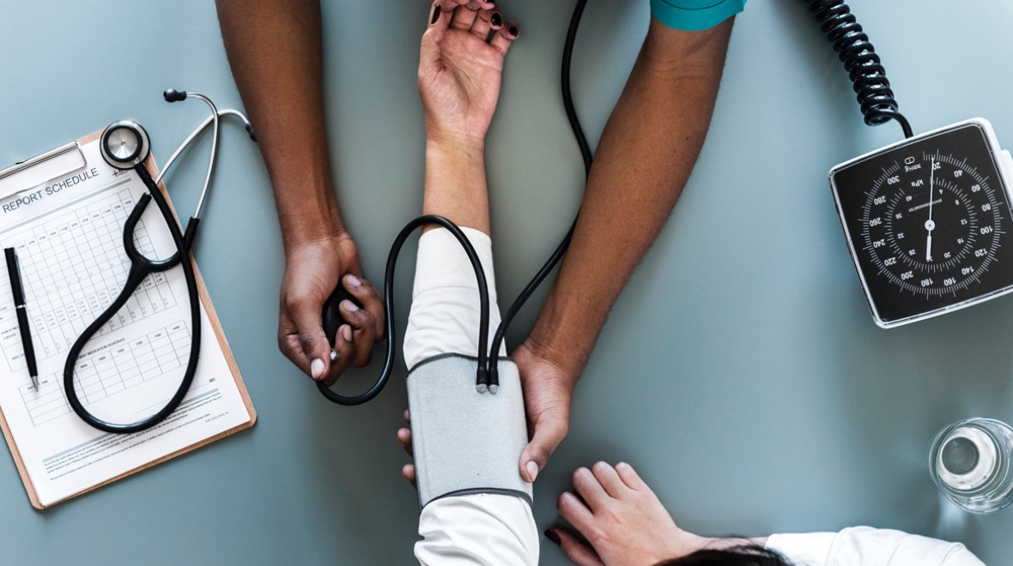
Measuring Characteristics of Individuals in Groups

Slide 5
Blood Pressure
Measure all the members of a group.
Without doing anything else, an hour later measure all the members of the same group again.
Would you expect that the average blood pressure for the group would be the same for each measurement?
Why would they be different?

Slide 6
Random Error
A random error, as the name suggests, is random in nature and very difficult to predict. It occurs because there are a very large number of potential variables beyond the control of the experimenter that may interfere with the results of the experiment.

Slide 7
Differences in blood pressure accounting for differences in group averages can be attributed to random error.

Slide 8
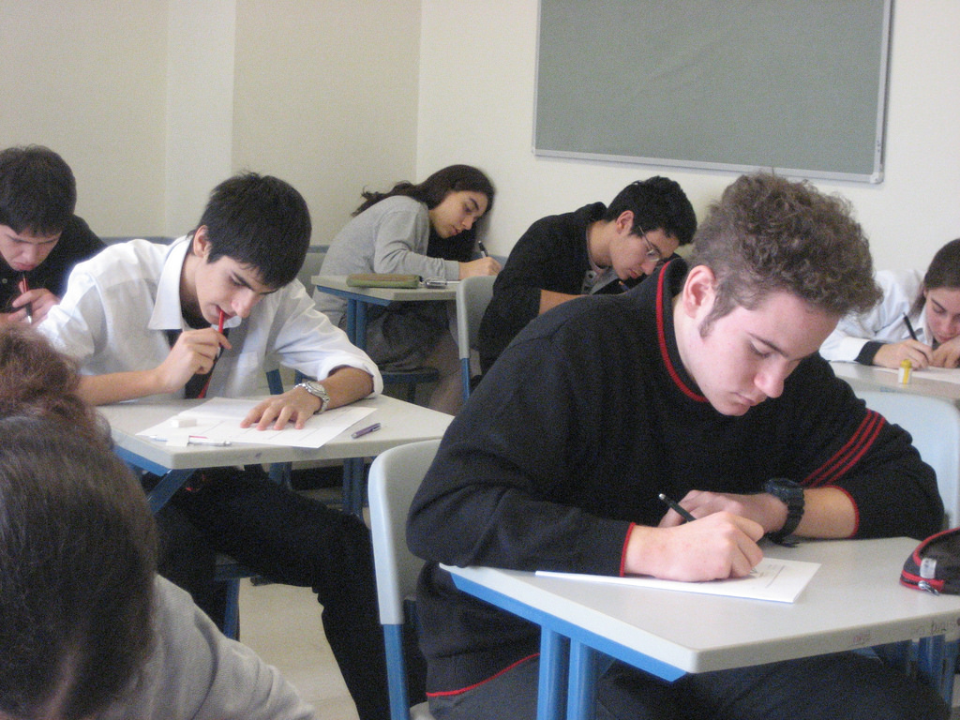
Measuring Characteristics of Individuals in Groups

Slide 9
Knowledge of Biology Facts
Measure all the members of a group.
Without doing anything else, an hour later measure all the members of the same group again.
Would you expect that the average biology fact knowledge for the group would be the same for each measurement?
Why would they be different?

Slide 10
We tend to think that academic knowledge is more stable than blood pressure but there is still lots of random error in group measurement.

Slide 11
And now… Blood Pressure
Get the average blood pressure of the individuals in a group.
Give every member of the group blood pressure lowering medication.
A week later, get the average blood pressure of the individuals in a group.
Would you expect that the average blood pressure for the group would be the same for each measurement?
Why would they be different?

Slide 12
The Statistical Problem
We already know that any two group measurements will be different because of random error.
We suspect that two group measurements will be different because we did something (gave them meds).
How do we know that the difference we thought would appear because we did something is not due to random error?

Slide 13
This is the same for the students…
Get the average biology fact knowledge of the individuals in a group.
Then teach biology facts.
A week later, get the average biology fact knowledge of the individuals in a group.
Would you expect that the average biology fact knowledge for the group would be the same for each measurement?
Why would they be different?

Slide 14
The Statistical Problem
We already know that any two group measurements will be different because of random error.
We suspect that two group measurements will be different because we did something (taught them biology facts).
How do we know that the difference we thought would appear because we did something is not due to random error?

Slide 15
Statistical Significance
The answer is the same in both cases.
The difference between the first group measurement and the second becomes so large the difference is unlikely to have appeared by chance (appeared by random error).
When the difference gets that big it is said to be statistically significant.

Slide 16
So, in this class…
The logic of comparing group averages is not complicated.
But, of course, the devil is in the details.
Most of this course is the details.

Slide 17
Statistics
Applying statistical analysis uses numbers.
Statistics talk about groups—not individuals.
So, the first thing to do is to figure out how to describe groups with numbers.
This is called descriptive statistics.

Slide 18
Descriptive Statistics
To study a group, we could just write out the response for each individual, but as the group size gets larger this is hard to handle.
So, descriptive statistics provide a way to talk about all the measurements of all of the individuals at the same time.
Descriptive statistics are the summary of measures of the characteristics of a group.

Slide 19
Statistics
If you want you can stop right here and use descriptive statistics as the basis of a study.
When you do this, it is a form of qualitative research—descriptive research.
You are reporting on what you have observed using numbers.
Or, you can use the descriptive statistics to figure out how big the differences in group measures are. That is called inferential statistics.

Slide 20
Inferential Statistics
Inferential statistics allow you to investigate meaningful relationships among groups including causal relationships.
Did the blood pressure medication cause the group’s blood pressure to go down?
Did the biology instruction cause the class’s biology knowledge to increase?

Slide 21
A bit more about the class…
Descriptive statistics—what are they and how do I use them?
Correlation—how do I figure out if two or more group measures are strongly related?
Inferential statistics—how do I figure out if two or more groups are substantially similar or different?
And then—what other details do I need to know to do all of this correctly?

Slide 22
How to get this information
Listen in class
Read assigned readings
Find things on the internet
Talk to you classmates or anyone else who can help
Some of this will require activities which fit in the category of studying.

